Slide 1
Lecture 6
Dr. Mohammed Abdul Baset
Chemical Reactions
Chemical reaction, a process in which one or more substances, the reactants, are converted to one or more different substances, the products.
Evidence for a chemical reactions
Rusting metal, candle burning, burning natural gas, bread making, automobile, fuel consumption, you hearing my voice, hand waving, burning of natural gas, blame, heat, smell, and moisture.
Typical gross clues of chemical reactions
1. The color changes
2. Physical form changes
3. Bubbles form
4. Heat is produced or is absorbed
1. Balancing chemical Equation
How to write and balance equations
1. Carefully read the description of the reaction. Know names of reactants from products.
2. Write the appropriate formulas for reactants and products.
3. Write a preliminary unbalanced equation that restates 1.
4. Balance the equation by inspection, starting with the most complicated molecule.
*Do not change the identities of reactants and products.
*An atom may be present as an element, a compound, or an ion.
Coefficients used must give the smallest integers to give a balanced equation.
Examples:
1-
Aluminum reacts with copper (II) chloride CuCl₂ to form copper metal and aluminum chloride AlCl3. Write the balanced equations for this reactions.
1. Identify the reactants and products.
Aluminum and copper (II) chloride are the reactants, and aluminum chloride and copper are the products.
2. Write a word equation for the reaction.
aluminum + copper (II) chloride A aluminum chloride + copper
3. Write the equation using formulas for the reactants and products.
Al + CuCl₂ → AlCl₃ + Cu
4. Balance the equation one element at a time. The same number of each type of atom must appear on both sides. To balance the number of chlorine atoms, you must multiply the amount of copper (II) chloride by 3 and multiply the amount of aluminum chloride by
29

Slide 2
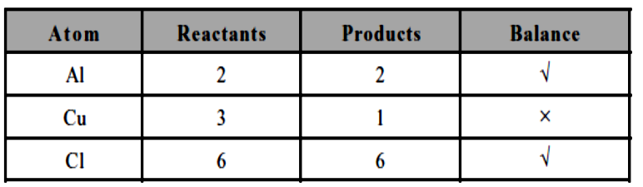
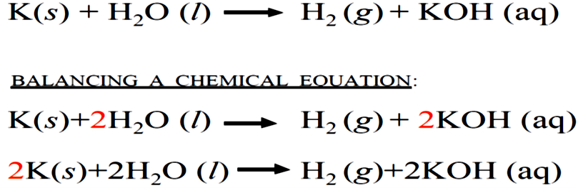
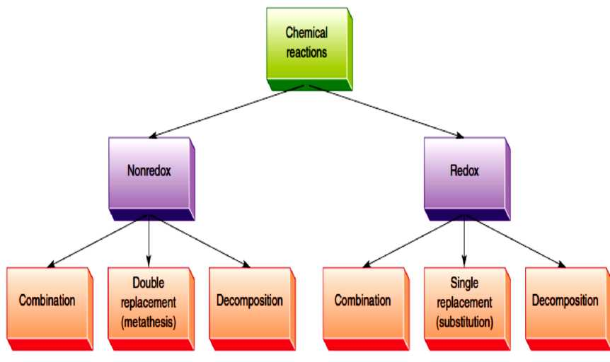
To balance the equation, multiply the amount of copper produced by 3.
2-
2. Types of chemical reactions
Most inorganic reactions can be classified into one of five general categories: direct union or combination, decomposition, displacement, metathesis or double displacement, and combustion reactions. Each of these will be discussed in more detail in the following:
30

Slide 3
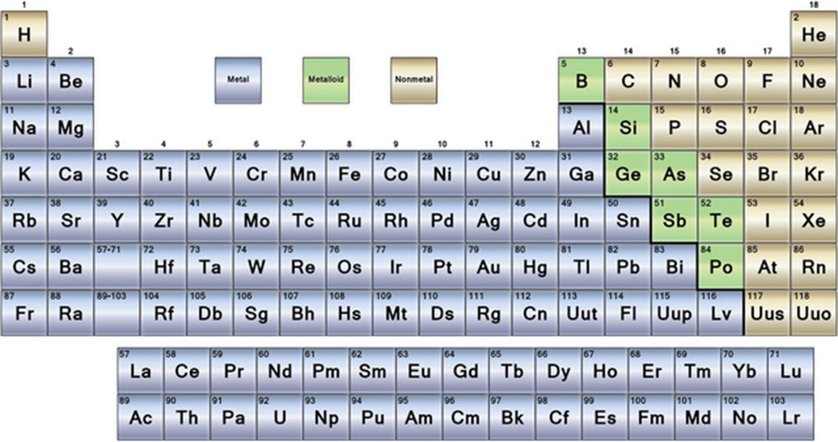
1. Direct Union or Combination Reactions
Any reaction in which two or more substances combine to form a single product is a direct union or combination reaction. The general form of a direct union reaction is
A + B →AB
This type of reaction generally takes place between the following types of compounds:
a. A metal + non-metal
2 Na + Cl2 → 2 NaCl
sodium chloride
Fe + S → FeS
iron(II) sulfide
b. Metal oxide + non-metal oxide
K2O + SO3 → K2SO4
potassium sulfur potassium
oxide trioxide sulfate
CaO + CO2 → CaCO3
calcium carbon calcium
oxide dioxide carbonate
c. Non-metal + non-metal
C + O2 → CO2
carbon
dioxide
N2 + 3 Cl2 → 2 NCI3
nitrogen
trichloride
2. Decomposition Reactions
In a decomposition reaction a compound is broken down into smaller compounds or separate elements. A decomposition reaction is the reverse of a synthesis reaction. The general form for a decomposition reaction is:
AB → A + B
Some examples of decomposition reactions are:
31

Slide 4
2 KCIO3 → 2 KCl + 3 O2
potassium potassium
chlorate chloride
CaCOs → CaO + CO2
calcium calcium carbon carbonate oxide dioxide
3. Single Replacement Reactions (Substitution)
A single replacement involves an element reacting with a compound whereby the element displaces a second element from the compound. The general form of this type reaction is:
A + BC → AC + B
Single replacement reactions usually occur between the following combinations:
a. An active metal + an acid
When a metal which is above hydrogen in the activity series is reacted with an acid, hydrogen is liberated and a salt is formed.
b. A metal + a salt
Each metal in the activity series displaces any metals below it to form a salt in solution.
c. A Halogen + halide salt
A halogen (F, Cl, Br, I, At) will displace any less active halogen from a halide salt. The order of activity decreases going from top to bottom down the halogen family in the periodic table.
4. Metathesis or Double Replacement Reactions
A metathesis is a double repplacement reaction that usually occurs in water solution. The general form of a metathesis reaction is:
AB + CD → AD + CB
The principal conditions that favor the completion of these reactions are:
a. Precipitation Reactions
32

Slide 5
In this type of reaction, two compounds which are water soluble react to form two new compounds, one of which is a precipitate (i.e. insoluble in water). The precipitate is often indicated by an arrow pointing downward, ↓, written next to its formula.
b. Neutralization Reactions (sometimes called acid-base reactions)
A neutralization reaction occurs between an acidic compound and a basic compound to form a chemical salt and water.
1. Reaction between an acid and a base
33

Slide 6
34

Slide 7
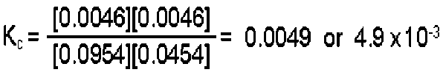
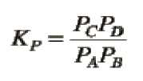
• Since Kc is being determined, check to see if the given equilibrium amounts are expressed in moles per liter (molarity). In this example they are not; conversion of each is required.
[CO₂] = 0.1908 mol CO₂/2.00 L = 0.0954 M
[H₂] = 0.0454 M
[CO] = 0.0046 M
[H₂O] = 0.0046 M
• Substitute each concentration into the equilibrium expression and calculate the value of the equilibrium constant.
For gaseous reactants it is more convenient to express the equilibrium condition in terms of the partial pressures of the reactants and products. For this case the equilibrium constant is defined
by
Relationship between Kc and Kp is:
K_{f}=K_{c}(BT)
Art
K_{c}: is an equilibrium constant in terms of molar concentrations, K_{p}: is an equilibrium constant in terms of partial pressures, T: temperature, R: Ideal Gas Constant (0.0821 literatm/molK), n: is number of moles.
4. Reaction rate
The rate of reaction, r, is defined to be the slope of the concentration-time plot for a species divided by the stoichiometric coefficient of that species. For the example shown
For the oxidation of ammonia
4NH3 +3O2 →1N2 +6H2O
it was found that the rate of formation of N2 was 0.27 mol L⁻¹ s⁻¹.
a. At what rate was water being formed?
b. At what rate was ammonia being consumed?
Solution
a) From the equation stoichiometry, A[H₂O] = 6/2 A[N₂], so the rate of formation of H₂O is
35

Slide 8
36

